Slide 1
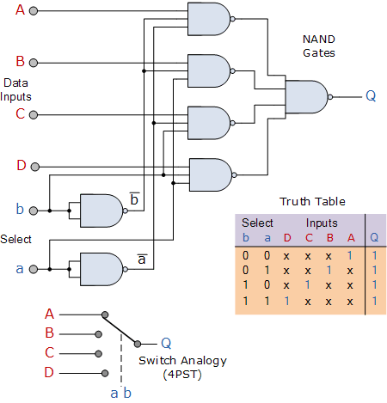
Fundamentals of Digital Logic Design

Slide 2
Outline
Review of the basic logic gates
Synthesis with AND, OR and NOT logic gates
  SOP & POS
Minimization Techniques
Chips & Gates
Analysis

Slide 3
Objectives
After studying this module, students should be able to:
Design combinational logic systems using Truth Tables and Boolean expressions
Use Boolean Axioms and Theorems to simplify logic circuits
2.2

Slide 4
Review - Electronic Logic
The most basic digital devices are called gates.
Gates got their name from their function of allowing or blocking (gating) the flow of digital information.
A gate has one or more inputs and produces an output depending on the input(s).
A gate is called a combinational circuit.
Three most important gates are: AND, OR, NOT

Slide 5
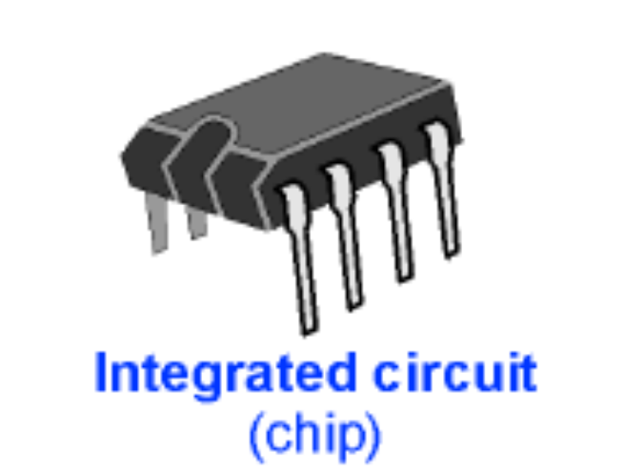
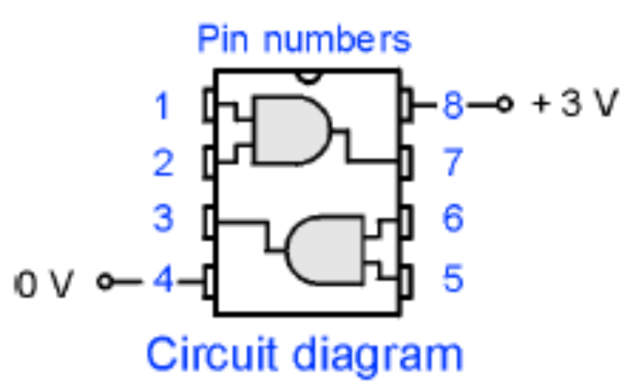
Review - Electronic Logic
Logic gates are built from many transistors in integrated circuits, commonly known as “chips.”
As their names imply, these gates compare two input voltages and produce an output voltage based on the inputs.

Slide 6
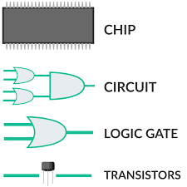
Classification of Digital Circuits
Combinational logic circuits.
  Output depends only on present input.
Sequential circuits.
  Output depends on present input and present state of the circuit.

Slide 7

Review - Logic Gates
Logic Systems, which includes computers, are built using logic gates
There are three basic logic gates: AND, OR, NOT and the derived gates: NAND, NOR, XOR, XNOR
AND gate
Description: The output is true only when ALL inputs are true. Or, when all inputs are a 1, then the output will be a 1 (for True=1)
Symbol:
Boolean Expression: A.B said as, A and B
2.3

Slide 8
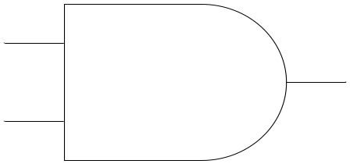
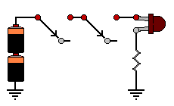
AND
A
Logic Gate:
A*B
Truth Table:
B
A | B | A*B
0 | 0 | 0
0 | 1 | 0
1 | 0 | 0
1 | 1 | 1
Series Circuit:
A Truth Table defines the output for ALL possible combinations of input

Slide 9
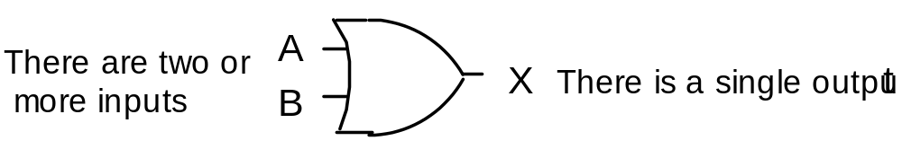
Logic Gates - OR
OR gate
Description: The output is true when ANY one OR more inputs is true
Symbol:
Boolean: A + B (said as, A or B)
2.5

Slide 10
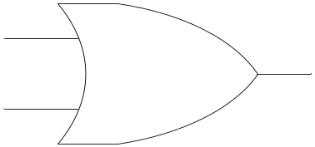
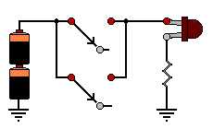
OR
A
Logic Gate:
A+B
Truth Table:
B
A | B | A+B
0 | 0 | 0
0 | 1 | 1
1 | 0 | 1
1 | 1 | 1
Parallel Circuit:

Slide 11

Logic Gates - NOT
NOT gate
Description: The output is at the opposite state to the input. That is, INVERTED.
Symbol:
Boolean X = A (said as, not A)
Expression:
O- Indicates inversion
2.7

Slide 12
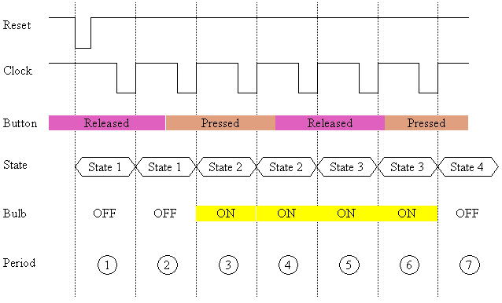
Timing Analysis
A timing diagram is a graph of the output of a logic gate with respect to the inputs of the gate. A timing diagram plots voltage (vertical) with respect to time (horizontal). A timing can also be seen as waveforms on an oscilloscope or on a logic analyzer.

Slide 13
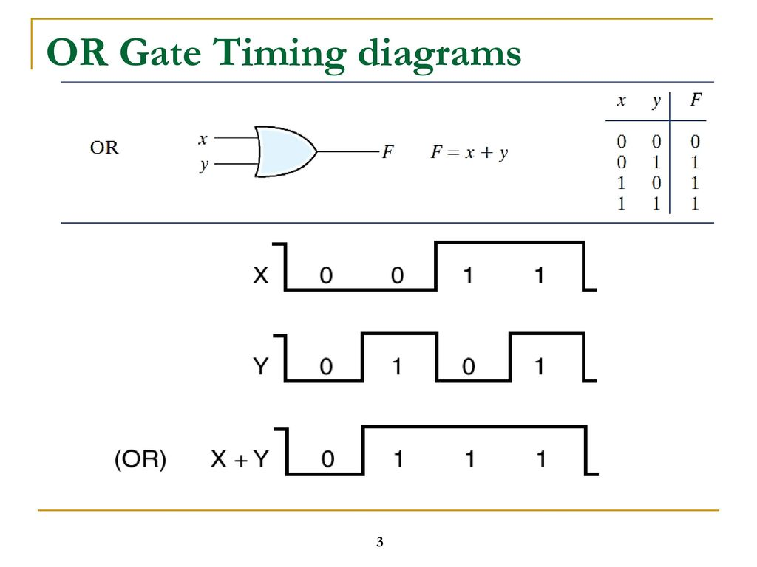

Slide 14
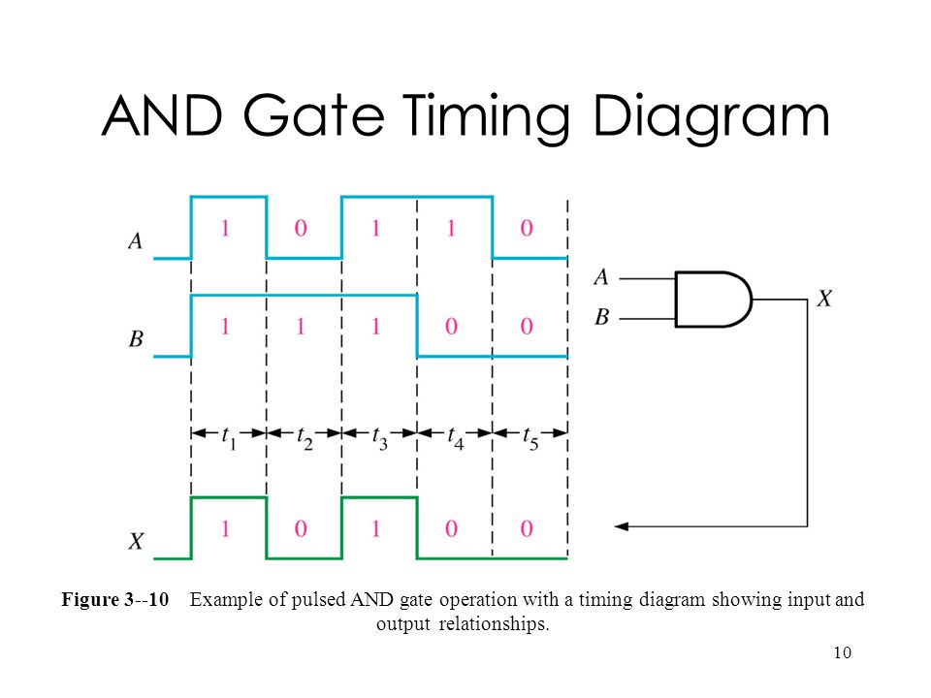

Slide 15
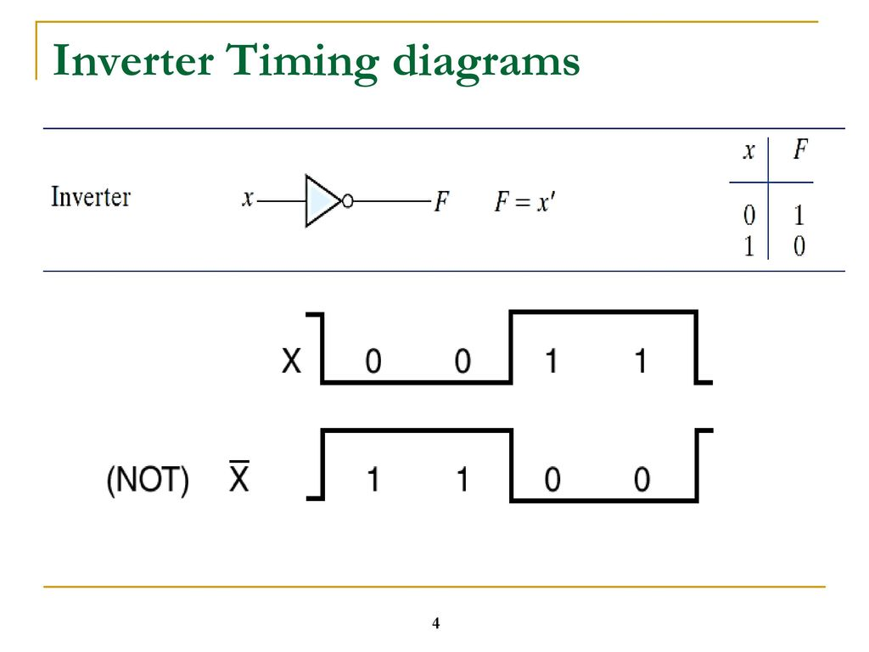

Slide 16
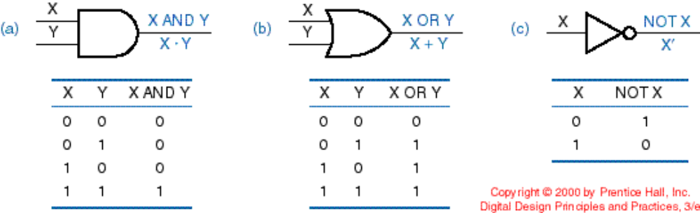
Synthesis using AND, OR and NOT Gates

Slide 17
Synthesis
The task of designing a new network that implements a desired functional behavior

Slide 18
Combinational Logic Design Procedure
Start with the problem statement.
Determine the number of inputs variables and the required number of output variables.
Derive a truth table that defines the required relationship between input and output.
  For small networks
From the Truth Table write out the Boolean expression.
Simplify each output function (Using Boolean algebra or Karnaugh maps).
The logic circuit is then drawn from the simplified Boolean expression

Slide 19
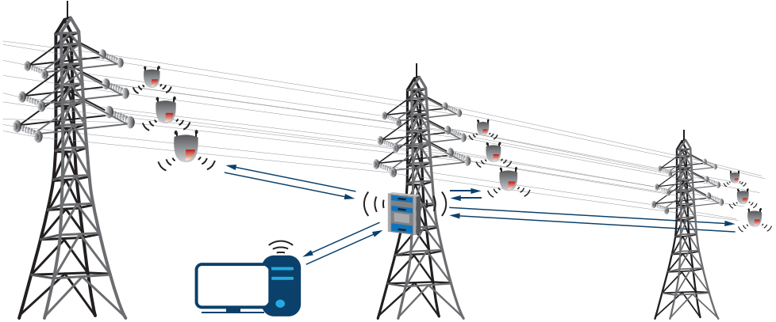
Example 1
Design a circuit to perform the following function. Two power lines are to be monitored for the occurrence of HIGH voltage signals. The function of the circuit is to monitor the state of two sensors attached to the power lines and output a high voltage to trigger an alarm system whenever there is a HIGH (LOGIC 1) on either one or both power lines

Slide 20
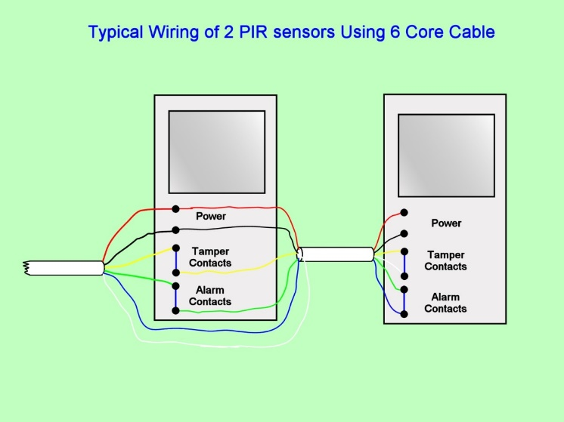
Example 1 Cntnd
The function of the circuit is to continuously monitor the state of the sensors and produce an output logic value 1, whenever the sensors are in the following state: (1, 0), (0, 1) and (1, 1). In other words the required functional behavior of the circuit is that the output must be equal to 1 whenever either or both of the sensors are at logic 1.

Slide 21
System Design Applications
The second step in any design problem is to express the problem in terms of a Boolean Expression. This can be done either from the requirements of the problem directly or from a truth table.
The next step is to reduce the expression to simplest terms and to put it in a desired format. This step may include the use of Boolean Algebra, k-maps or both.
The third step is to implement the function by drawing the logic using the available circuits

Slide 22
Step 2
Determine the number of inputs variables and the required number of output variables.
Determine the possible number of valuations for the given number of inputs, n (2^{n} = valuations)
Derive a truth table that defines the required relationship between input and output.
X | y | A
0 1 0 1 | 0 0 1 1 | 0 1 1 1

Slide 23
Step 3 - From the Truth Table write out the Boolean expression
A possible procedure for writing the Boolean expression from the truth table is to create a product term that has a value of 1 for each valuation for which the output function A has to be 1 (SoP - realization)
X | y | A
0 1 0 1 | 0 0 1 1 | 0 1 1 1

Slide 24
Sum-of-products realization
X | y | A
0 1 0 1 | 0 0 1 1 | 0 1 1 1
X.Y
X.Y
minterms
X.Y
(AND)
A= ( X · Y) + ( X · Y) + (X · Y )
Canonical sum of products

Slide 25
Constructing a logic circuit from a Boolean expression
( X · Y) + ( X · Y) + (X · Y ) = A
A

Slide 26
Constructing a logic circuit from a Boolean expression – SoP realization
( X · Y) + ( X · Y) + (X · Y ) = A
x
X
Y
Y
X
A
Y
X
Y

Slide 27
SOP and POS Representations
Any logic expression is expressed in the following two standard forms:
  Sum-of-Products form (SOP)
  Product-of-Sums form (POS)
These two forms are helpful for reducing given logic expressions to its simplest form

Slide 28
Writing SoP from truth tables
The follow shows the procedure on how to write SoP from truth table:
  First, consider only the combinations that have their output as a 1.
  Then, write a product term of each such combination
  Lastly, OR all these product terms to get the SOP form

Slide 29
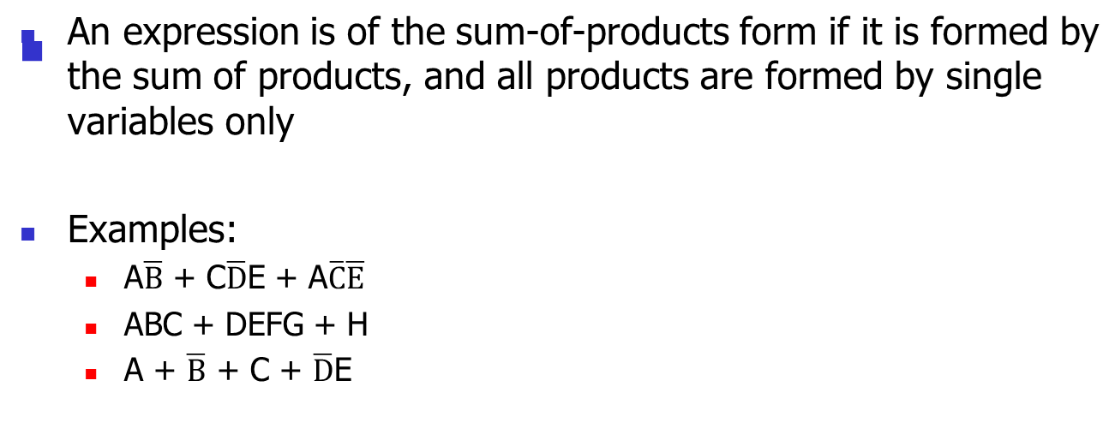
Sum-of-Products (SOP) Form

Slide 30

Example
From the truth table obtain the logical expression in the SoP form
A | B | Y
0 | 0 | 0
0 | 1 | 1
1 | 0 | 1
1 | 1 | 0

Slide 31
Practice Question
For the truth table given, write the logic expression of output Y in the SoP form
A | B | C | Y
0 | 0 | 0 | 0
0 | 0 | 1 | 1
0 | 1 | 0 | 0
0 | 1 | 1 | 1
1 | 0 | 0 | 1
1 | 0 | 1 | 0
1 | 1 | 0 | 0
1 | 1 | 1 | 1

Slide 32
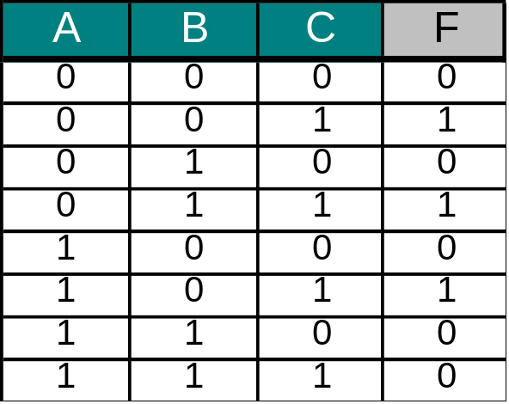
Combinational Circuits
Standard representation of Logic Function using SoP
A,B,C = Inputs
F(ABC) = Output
minterms
(AND)
Minterm: is the product term that is 1 in one row of the TT
F= ( A · B · C) + ( A · B · C) + (A · B · C )
SUM OF PRODUCTS (CANONICAL SUM)

Slide 33
Product-of-Sums (POS) Form
To write a Boolean expression using PoS: from the truth table create a sum term that has a value of 0 for each valuation for which the output function A has to be 0 and find the product of all the sums terms (PoS - realization)
X | y | A
0 1 0 1 | 0 0 1 1 | 0 1 1 1

Slide 34
Writing PoS from truth tables
The follow shows the procedure on how to write PoS from truth table:
  First, consider only the combinations that have their output as a 0.
  Then, write the maxterms for such combinations
  Lastly, AND all the maxterms to obtain the PoS form

Slide 35
Combinational Circuits
Standard representation of Logic Function using PoS
A,B,C = Inputs
maxterms
F(ABC) = Output
(OR)
Maxterm: is the sum term that is 0 in one row of the TT
F= ( A + B + C) · ( A + B + C) · (A + B + C) · ( A + B + C) · (A + B + C)
PRODUCT OF SUMS (CANONICAL PRODUCT)
Julio D. Dondo Gazzano FPGA & VHDL WORKSHOP KUMASI GHANA- 2005

Slide 36
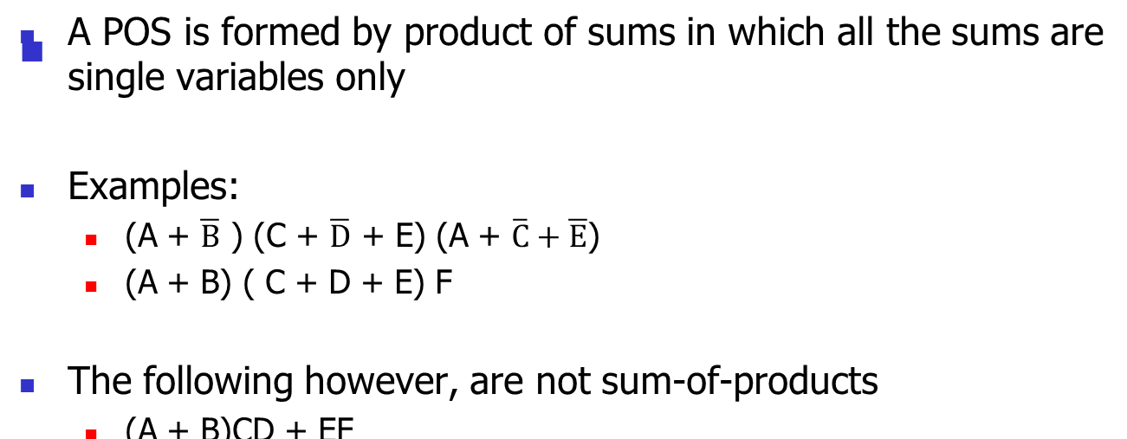
Product-of-Sums (POS) Form

Slide 37
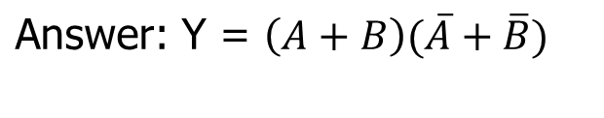
Example
From the truth table obtain the logical expression in the SPOS form
A | B | Y
0 | 0 | 0
0 | 1 | 1
1 | 0 | 1
1 | 1 | 0

Slide 38

Example Problem -2
A bulb in a staircases has two switches, one switch being at the ground floor and the other one at the first floor. The bulb can be turned ON and also can be turned OFF by any one of the switches irrespective of the state of the other switch. Find (a) a truth function, (b) a Boolean expression, and (c) a logic network that allows the light to be switched on or off by either switch.
Let A and B be the switches:
A | B | F(A,B)
0 | 0 | 0
0 | 1 | 1
1 | 0 | 1
1 | 1 | 0

Slide 39
Problem -2 Cntnd
Let both the switches be in off position (first row of truth table) the bulb is off (since F = 0). If switch (A) is put on (A = 1) then the bulb is turned on (F = 1) OR of switch (B) is put on then also the bulb turns. Similarly you can verify for the bulb to be off from either floor
A | B | F(A,B)
0 | 0 | 0
0 | 1 | 1
1 | 0 | 1
1 | 1 | 0

Slide 40

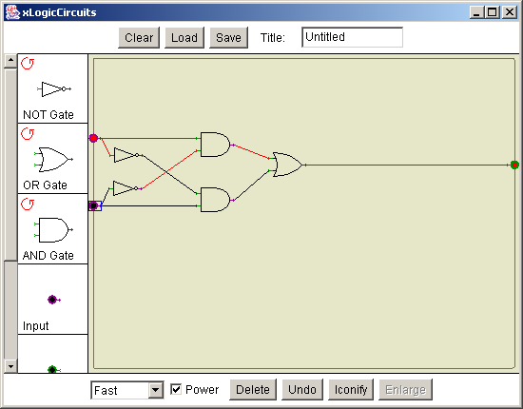
Example (cont)
One possible equation is the complete sum-of-products form:
Use a circuit simulation software to implement this equation
A | B | F(A,B)
0 | 0 | 0
0 | 1 | 1
1 | 0 | 1
1 | 1 | 0

Slide 41
Minimization techniques
SoP and PoS methods always produces a logical expression, but usually is not the simplest or minimum expression.
By simplification or minimization we actually mean, optimizing some engineering criteria such as minimizing total number of gates, the delay, maximizing the reliability, etc.

Slide 42
Ways of Simplifying Boolean Function
Algebraic Method
Karnaugh-map (K-Map)
Quine-McClusky Method

Slide 43
Boolean (Binary) Algebra
Boolean Algebra is used to simplify and analyze digital (i.e. logic) circuits
Because of the binary numbers, it is also called binary or logical algebra
Boolean Algebra was invented by George Boole in 1854

Slide 44
Boolean Vs. Conventional Algebra
Boolean Algebra is different in the following ways:
  Symbols used in Boolean Algebra do not represent numerical values
  Arithmetic operations (addition, subtraction, division, etc.) are not performed in Boolean algebra
  There are no fractions, negative numbers, square, square roots, etc.
  The most important point is that Boolean algebra allows only two values (0 and 1) for any variable

Slide 45

Boolean algebra
Boolean algebra provides an effective means of describing circuits built with switches, hence it can be used to describe logic circuits.
It is a powerful tool that can be used for designing and analyzing logic circuits
It provides the foundation for much of our modern digital technology
Boolean algebra is based on a set of rules that are derived from a small number of basic assumptions
Boolean algebra

Slide 46
Boolean Postulates
1(a). Closure with respect to operator (+)
  When operator (+) is used over two binary elements, it results in a unique binary element.
1(b). Closure with respect to operator (.)
  When operator (.) is used over two binary elements, it results in a unique binary element.
2(a). The identity element with respect to (+) is designated by 0
A+0 = 0+A = A
2(b). The identity element with respect to (.) is designated by 1
  A . 1= 1 . A = A

Slide 47
Boolean Postulates
3(a). Commutative with respect to (+)
A+B = B+A
3(b). Commutative with respect to (.)
A . B = B . A
4(a). (.) is distributive over (+)
A . (B+C) = (A . B) + (A . C)
4(b). (+) is distributive over (.)
A+ (B . C) = (A+B) . (A+C)

Slide 48
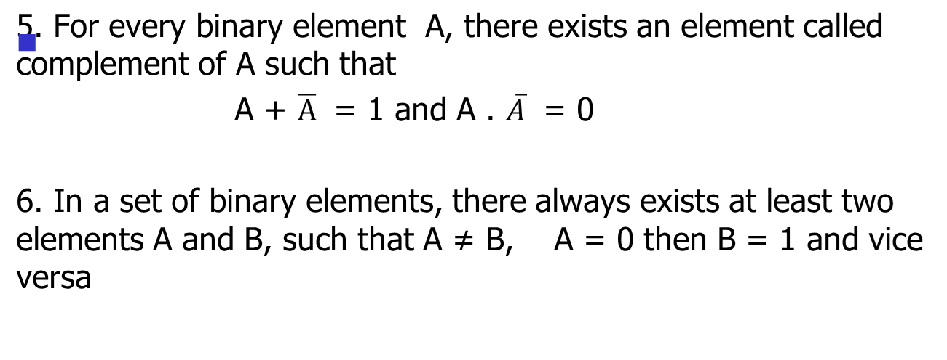
Boolean Postulates

Slide 49
Boolean Law
Commutative Law
AND Law
Associative Law
OR Law
Distributive Law
Inversion Law

Slide 50
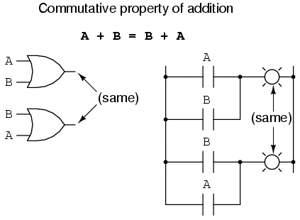
Commutative Law

Slide 51
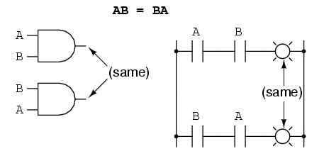
Commutative Law

Slide 52
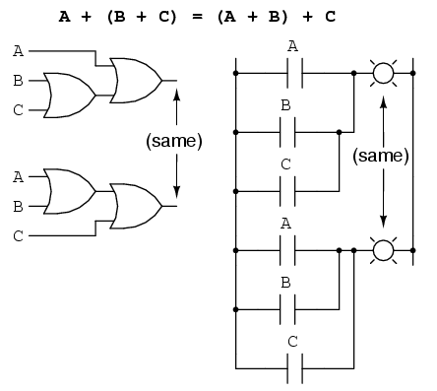
Associative Law

Slide 53
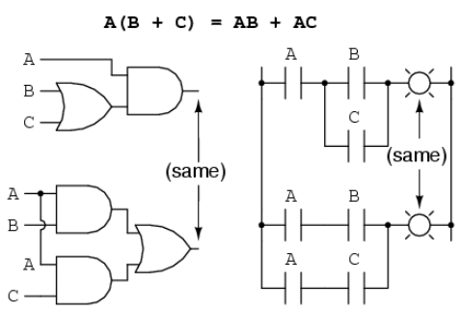
Distributive Law

Slide 54
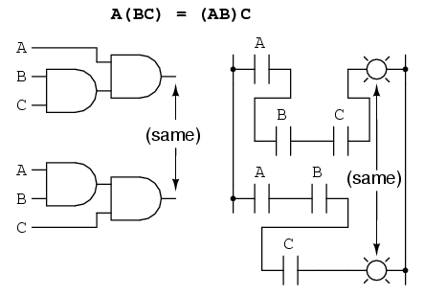
Associative Law

Slide 55
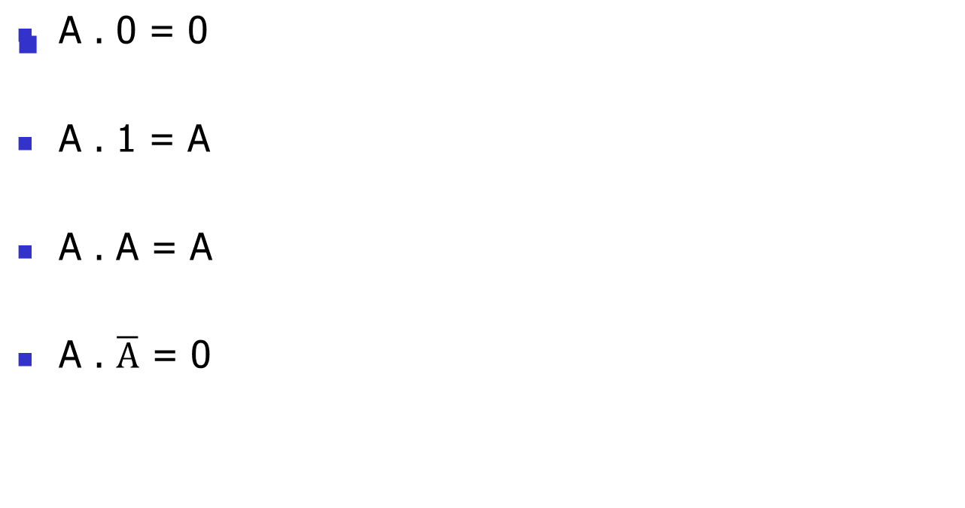
AND Law

Slide 56

OR Law

Slide 57
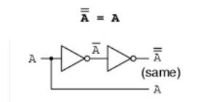
Inversion Law
This uses the NOT operation
It states that the double inversion of a variable results in the original variable itself.

Slide 58
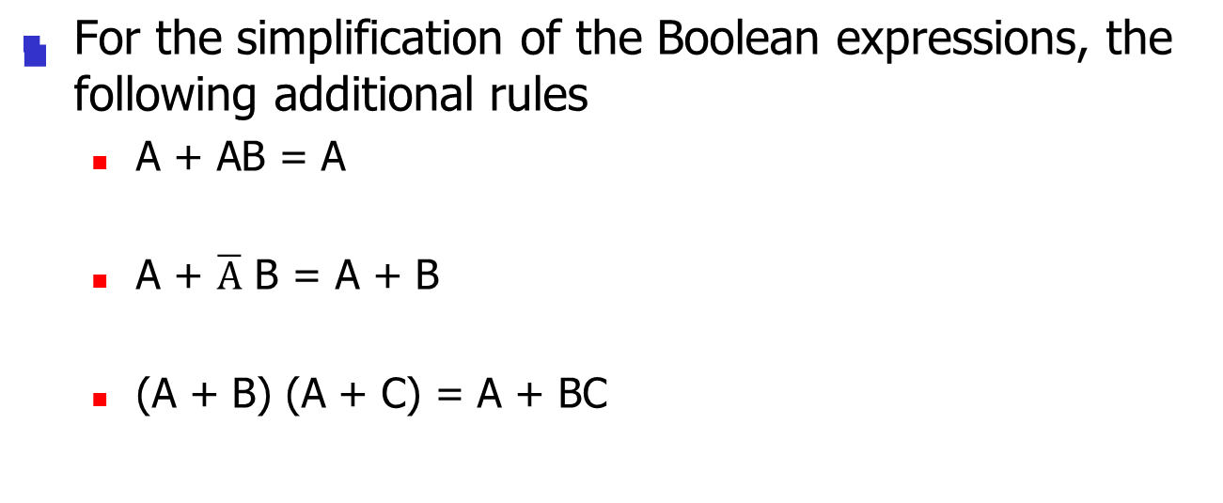
Other Important Rules

Slide 59
Proof of important rules
A + A . B = A
  A + A . B = A . ( 1+ B)
  But 1 + B = 1
  = A . 1
  = A

Slide 60
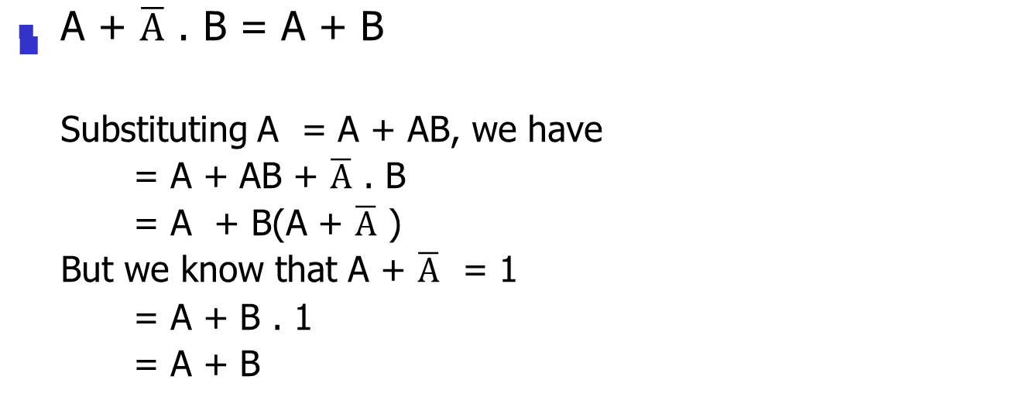
Proof of important rules

Slide 61
Proof of important rules
(A + B) . (A + C) = A + B . C
(A + B) . (A + C) = A . A + A . C + B . A + B . C
  But A . A = A and B . A = A . B
(A + B) . (A + C) = A + A . C + A . B + B . C
But A + AB = A
(A + B) . (A + C) = A + A . C + B . C
(A + B) . (A + C) = A . (1 + C) + BC
But 1 + C = 1
= A . 1 +B . C
= A + B . C

Slide 62
Duality Principle
According to the duality principle, the following conversions are possible in a given Boolean expression
  We can change each AND operation to an OR operation
  We can each OR operation to an AND operation
  We can compliment any 1 or 0 appearing in the expression

Slide 63
Duality Principle
The duality principle is sometimes useful in creating new expressions from the given Boolean expression
Any theorem or identity in switching algebra remains true if 0 and 1 are swapped and (.) and (+) are also swapped.
For example,
  A + 1 = 1; A . 0 = 0
  A . (B+ C) = A . B + A . C; A+(B . C) = A + B . A + C

Slide 64
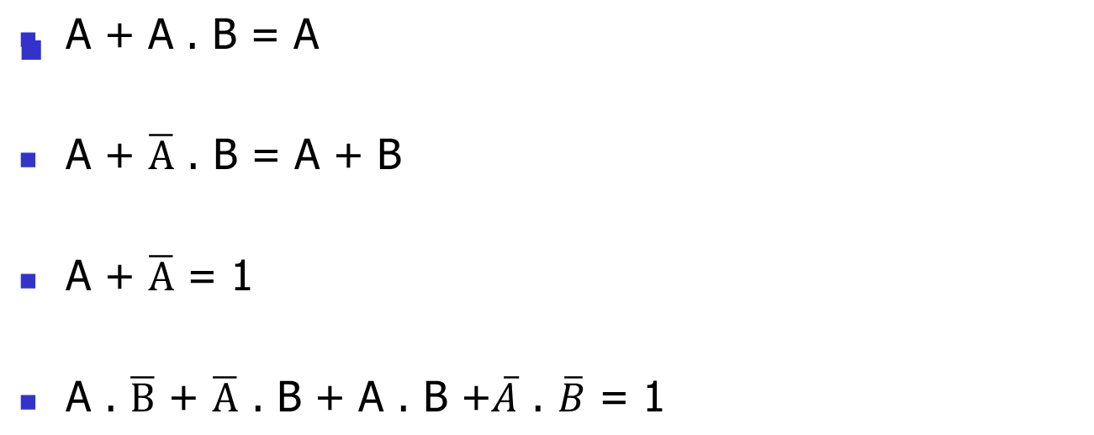
Duality Practice Questions

Slide 65
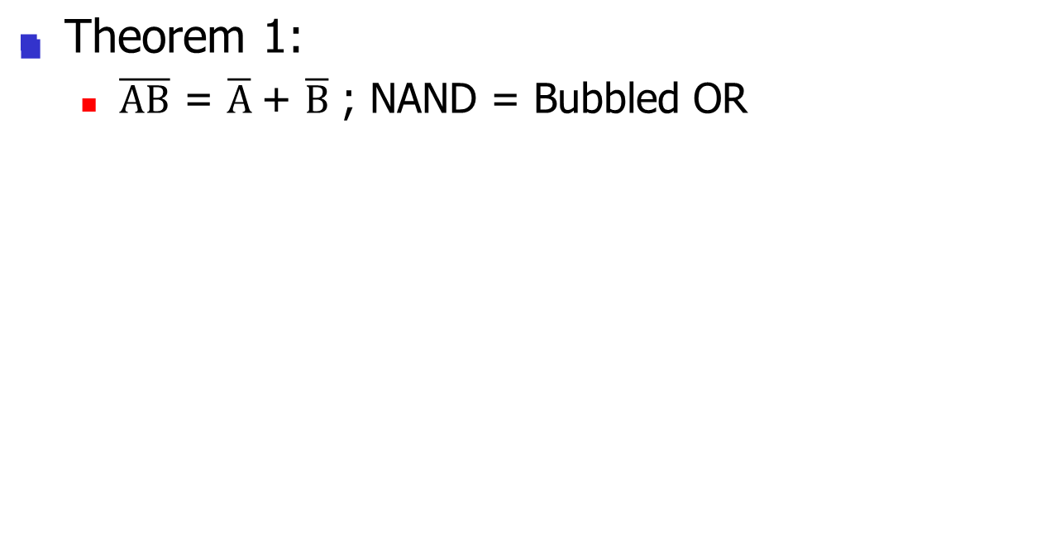
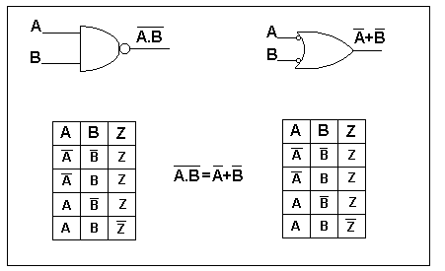
DeMorgan’s Theorem

Slide 66
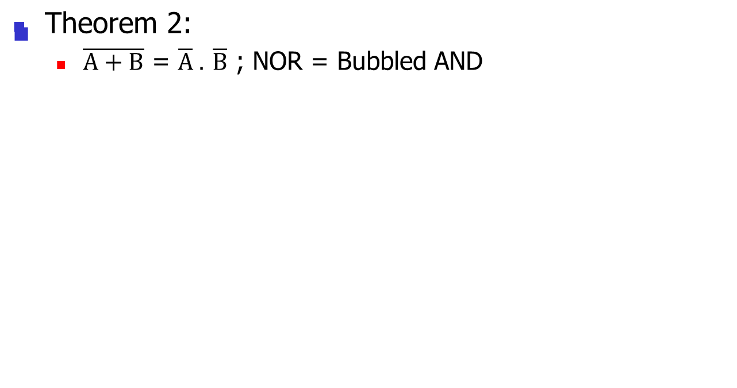
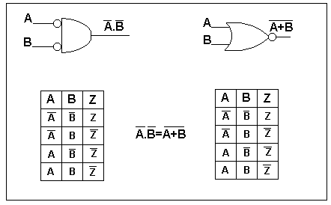
DeMorgan’s Theorem

Slide 67
Minimization techniques
X
A = X . Y + X . Y + X . Y
x
Y
Y
= X . Y + X . Y + X . Y
X
A
Y
= X (Y + Y) + X . Y
X
Y
= X .1 + X . Y
= X + X . Y
X
A = X + Y
A
Y

Slide 68
Boolean rules for simplification
Boolean algebra finds its most practical use in the simplification of logic circuits. If we translate a logic circuit's function into symbolic (Boolean) form, and apply certain algebraic rules to the resulting equation to reduce the number of terms and/or arithmetic operations, the simplified equation may be translated back into circuit form for a logic circuit performing the same function with fewer components. If equivalent function may be achieved with fewer components, the result will be increased reliability and decreased cost of manufacture.
We can also use K-maps

Slide 69
Some more examples on simplification

Slide 70
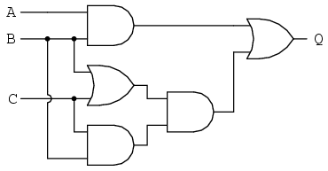
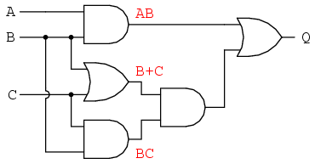
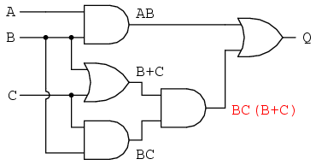
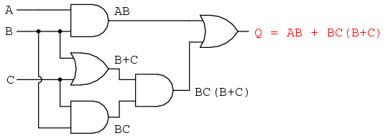
Our first step in simplification must be to write a Boolean expression for this circuit. This task is easily performed step by step if we start by writing sub-expressions at the output of each gate, corresponding to the respective input signals for each gate. Remember that OR gates are equivalent to Boolean addition, while AND gates are equivalent to Boolean multiplication.

Slide 71
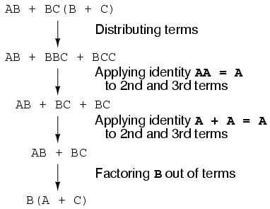
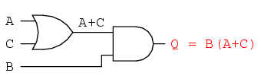
The final expression, B(A + C), is much simpler than the original, yet performs the same function. If you would like to verify this, you may generate a truth table for both expressions and determine Q's status (the circuits' output) for all eight logic-state combinations of A, B, and C, for both circuits. The two truth tables should be identical.

Slide 72
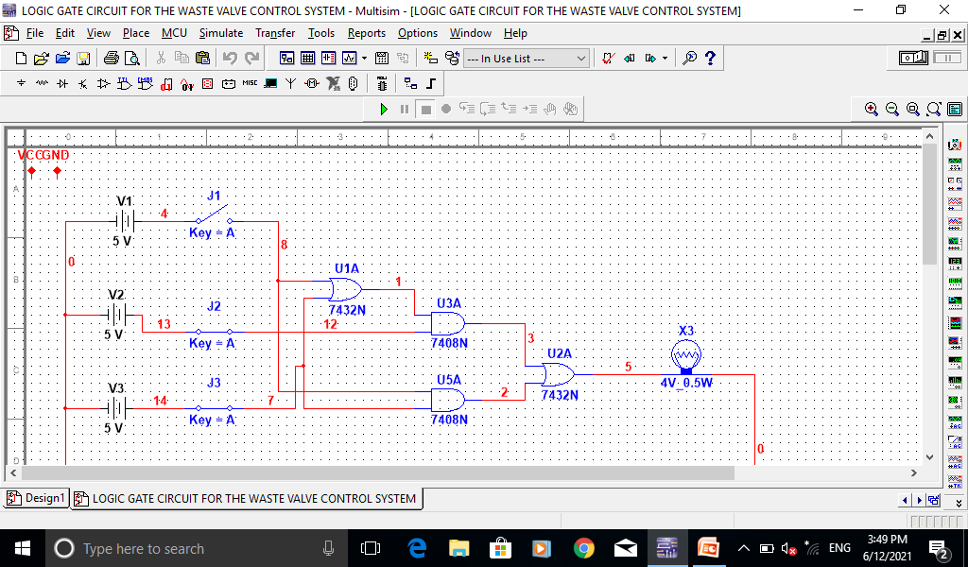
Boolean equations can be implemented using a circuit simulation software

Slide 73
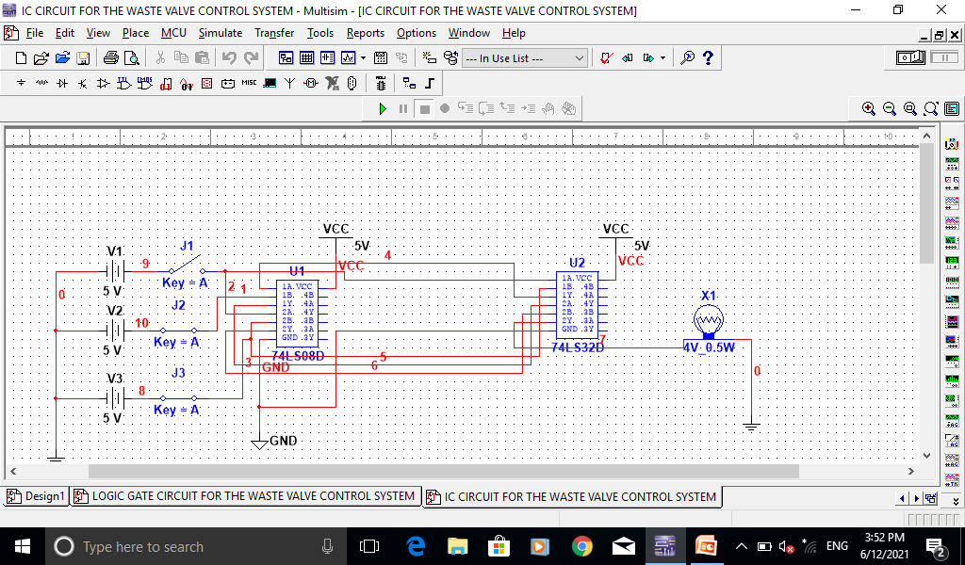
Boolean equations can be implemented using a circuit simulation software

Slide 74
Useful Resources
Textbooks on Digital Electronics (used is ok!)
Electronics Workbench or other electronic simulation software
Craig Maynard’s Virtual Vulcan
The following web sites:
  http://learnat.sait.ab.ca/ict/digi240_godin/default.htm
  http://learnat.sait.ab.ca/ict/cmph200/Default.htm
  http://learnat.sait.ab.ca/ict/cmph200_godin/default.htm
  http://focus.ti.com/docs/logic/logichomepage.jhtml
  http://www.onsemi.com
  http://www.national.com/
  http://www.play-hookey.com/digital/
  http://www.crhc.uiuc.edu/~drburke/databookshelf.html
  http://www.digikey.ca/

Slide 75
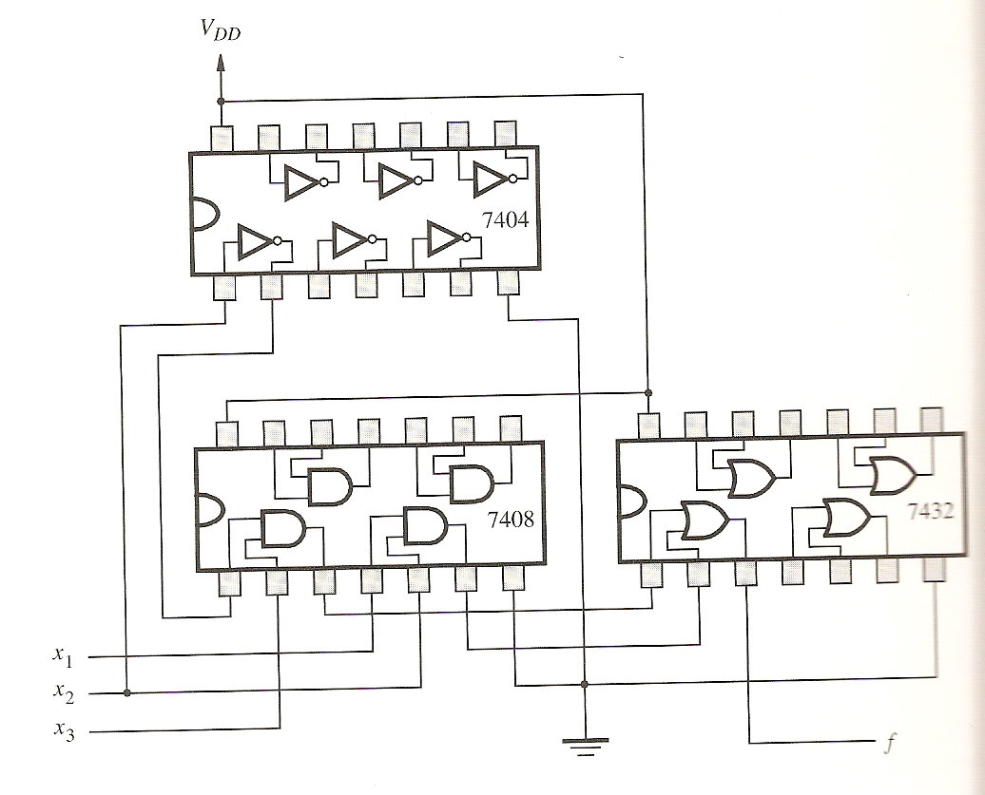
To build a logic circuit, the designer chooses the chips that perform whatever functions are needed and then defines how these chips should be interconnected to realize a larger logic circuit.
f = x₁x₂ + x₂x₃

Slide 76
Summary
A straight forward implementation of a function can be obtained by using a product term (AND gate) for each row of the truth table for which the function is equal to 1
The sum of these products realizes the desired function.
There are many different networks that can realize a given function. Some networks are simpler than others.
Algebraic manipulation can be used to derive simplified logic expressions and thus lower cost networks

Slide 77
AOI Gates for Implementing S-O-P Expression
Most Boolean reductions result in a Product-of-Sums (POS) expression or a Sum-of-Products (SOP) expression.
The Sum-of-Products means the variables are ANDed to form a term and the terms are ORed. X = AB + CD.
The Product-of-Sums means the variables are ORed to form a term and the terms are ANDed. X = (A + B)(C + D)
AND-OR-Inverter gate combinations (AOI) are available in standard ICs and can be used to implement SOP expressions.
The 74LS54 is a commonly used AOI.
Programmable Logic Devices (PLDs) are available for larger and more complex functions than can be accomplished with an AOI

Slide 78
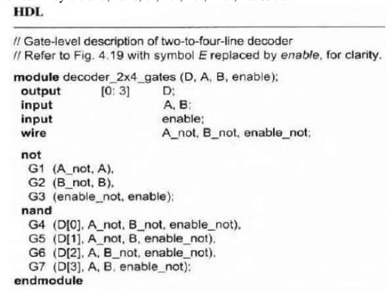
CAD tools (wait for this lecture)
Logic circuits found in complex systems, such as computers cannot be designed manually – they are designed using sophisticated CAD tools that automatically implement the synthesis technique
CAD tools are usually packaged together

Slide 79
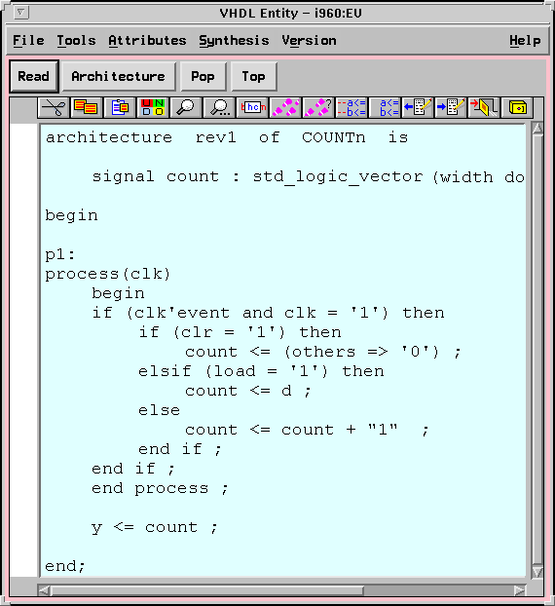
Step 2 – Design Entry
Entering into the CAD system a description of the circuit being designed
  Schematic capture
  Hardware Descriptive language (HDL)

Slide 80
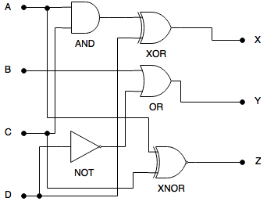
( & = AND ), ( ~ = NOT ), ( | = OR ), ( ^ = XOR ), ( ^~ = XNOR )
the same circuit using Verilog
module logic(input a, b, c, d, output x, y, z);
assign x = (a & c) ^ d;
assign y = b | ~d;
assign z = c ^~ a;
endmodule

Slide 81
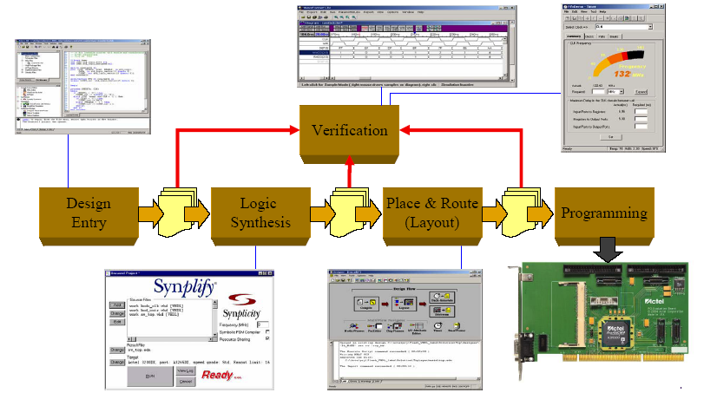
Simplified FPGA design implementation flow

Slide 82
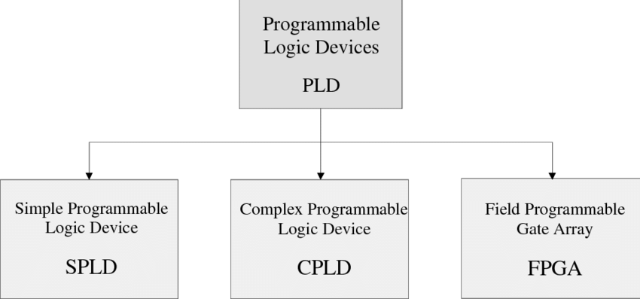



Slide 83


Slide 84


Slide 85
General Features of the FPGA
Fully programmable digital integrated circuits:
  One time programmable (antifuse or PROM based)
  Re-programmable (SRAM or FLASH based)
  Up to 10Million gates
  Up to 2000 pins with programmable signal levels
Built from:
  Programmable logic blocks with few registers (flip-flops)
  Programmable interconnects (limits performance)
  Programmable inputs/outputs
  Configurable memories
  Special blocks: DLL, PLL, Processor, PCI interface, etc.
Low development costs:
  Relatively “Cheap” and “easy” to use PC based tools
  Short development time (trial and error development possible)
  No development of production test procedures
  Production costs can be quite high for high gate count devices

Slide 86


Slide 87
SOME REFERENCES
Books on VHDL and FPGA design:
  The Design Warrior’s guide to FPGAs,
  Cleve “Max” Maxfield (Elsevier, 2004)
  Fundamentals of Digital Logic with VHDL Design,
    Stephen Brown and Zvonko (McGraw-Hill, 2000)
  Real Chip Design and Verification,
    Ben Cohen, (VhdlCohen Publishing, 2002)
Web sites:
  www.opencores.org, http://asics.ws,
  www.fpga4fun.com, www.us.design-reuse.com,
  www.fpga-faq.org, http://www.andraka.com/papers.htm, …
  Websites of FPGA companies (Actel, Altera, Xilinx,…)

Slide 88


Slide 89


Slide 90
Combinational Logic
A circuit that utilizes more that 1 logic function has Combinational Logic.
As an example, if a circuit has an AND gate connected to an Inverter gate, this circuit has combinational logic.

Slide 91

Combinational logic
How would you describe the output of this combinational logic circuit?

Slide 92

NAND Gate
The NAND gate is the combination of an NOT gate with an AND gate.
The Bubble in front of the gate is an inverter.

Slide 93


TRUTH TABLE FOR THE "NAND" GATE
Input | Input | Output
A | B | C
0 | 0 | 1
0 | 1 | 1
1 | 0 | 1
1 | 1 | 0
A NAND gate is the combination of both an AND gate and a NOT gate. It operates
the same as an AND gate but the output will be the opposite. Remember
the NOT gate does not always have to be on the output leg; it could be used to invert an
Input signal also.

Slide 94


Combinational logic
How would your describe the output of this combinational logic circuit?

Slide 95

NOR gate
The NOR gate is the combination of the NOT gate with the OR gate.
The Bubble in front of the gate is an inverter.

Slide 96


TRUTH TABLE FOR THE "NOR" GATE
Input | Input | Output
A | B | C
0 | 0 | 1
0 | 1 | 0
1 | 0 | 0
1 | 1 | 0
A NOR gate is the combination of both an OR gate and a NOT gate. It operates the same as an OR gate, but the output will be the opposite.

Slide 97
NAND and NOR gates
The NAND and NOR gates are very popular as they can be connected in more ways than the simple AND and OR gates.
And they can greatly simplify circuit diagrams. As we will see, you can use these gates wherever you could use AND, OR, and NOT.

Slide 98

NAND and NOR as Universal Logic Gates
Any logic circuit can be built using only NAND gates, or only NOR gates. They are the only logic gate needed.
Here are the NAND equivalents:

Slide 99

NAND and NOR as Universal Logic Gates (cont)
Here are the NOR equivalents:
NAND and NOR can be used to reduce the number of required gates in a circuit.

Slide 100
5.5 Universal Capability NAND and NOR
NAND and NOR gates are universal logic gates.
The AND, OR, NOR and Inverter functions can all be performed using only NAND gates.
The AND, OR, NAND and Inverter functions can all be performed using only NOR gates.
An inverter can be made from a NAND or a NOR by connecting all inputs of the gate together.
If the output of a NAND gate is inverted, it becomes an AND function.

Slide 101
5.5 Universal Capability NAND and NOR
If the output of a NOR gate is inverted, it becomes an OR function.
If the inputs to a NAND gate are inverted, the gate becomes an OR function.
If the inputs to a NOR gate are inverted, the gate becomes an AND function.
When NAND gates are used to make the OR function and the output is inverted, the function becomes NOR.
When NOR gates are used to make the AND function and the output is inverted, the function becomes NAND

Slide 102




Slide 103

5.4 De Morgen’s Theorem
To simplify circuits containing NAND and NOR gates we use this theorem
De Morgan's theorem allows large bars in a Boolean Expression to be broken up into smaller bars over individual variables.
De Morgan's theorem says that a large bar over several variables can be broken between the variables if the sign between the variables is changed.
In order to reduce expressions with large bars, the bars must first be broken up. This means that in some cases, the first step in reducing an expression is to use De Morgan's theorem.

Slide 104
DeMorgan’s Theorem

Slide 105
DeMorgan’s Theorem

Slide 106


Slide 107


To simplify circuits containing NAND and NOR gates we use this theorem.
Applying De Morgan's theorem produces

Slide 108

Example 2

Slide 109


Slide 110

Any AND-OR network can be implemented as a NAND-NAND network having the same topology
A OR-AND network can be implemented as a NOR-NOR network having the same topology
NAND and NOR gates are realized with simpler electronic circuits than AND and OR gates

Slide 111

The Exclusive-OR, or XOR Gate
  The Exclusive-OR, or XOR function is an interesting and useful variation on the basic OR function. Verbally, it can be stated as, "Either A or B, but not both." The XOR gate produces a logic 1 output only if its two inputs are different. If the inputs are the same, the output is a logic 0.
  The XOR symbol is a variation on the standard OR symbol. It consists of a plus (+) sign with a circle around it. The logic symbol, as shown here, is a variation on the standard OR symbol.
  Unlike standard OR/NOR and AND/NAND functions, the XOR function always has exactly two inputs, and commercially manufactured XOR gates are the same. Four XOR gates fit in a standard 14-pin IC package.
Input 1 | Input 2 | Output
0 | 0 | 0
0 | 1 | 1
1 | 0 | 1
1 | 1 | 0

Slide 112

XOR
Exclusive OR
Symbol:
Boolean X = A + B
Expression:
Truth Table: A B X
0 0 0
0 1 1 The output is TRUE when
1 0 1 the inputs are DIFFERENT
1 1 0
2.13

Slide 113


XOR
In order for the Output of an XOR
Logical Function to be TRUE: input (1) & input (2)
must both be different--01, 10. This is Positive Logic

Slide 114

Deriving the XOR Function
The Exclusive-OR, or XOR function can be described verbally as, "Either A or B, but not both." In the realm of digital logic there are several ways of stating this in a more detailed and precise format. We won't go here into such devices as Truth tables and graphic representations. We will stick with the more complete verbal statement, "NOT A and B, or A and NOT B."

Slide 115

XNOR gate
Input 1 | Input 2 | Output
0 | 0 | 1
0 | 1 | 0
1 | 0 | 0
1 | 1 | 1
The XNOR (exclusive-NOR) gate is a combination XOR gate followed by an inverter. Its output is "true" if the inputs are the same, and "false" if the inputs are different.

Slide 116

XNOR
Exclusive NOR
Symbol:
Boolean X = A + B
Expression:
Truth Table: A B X
0 0 1
0 1 0 The output is TRUE when
1 0 0 the inputs are the SAME
1 1 1
2.14

Slide 117
Read chapter 5 of the recommended text book

Slide 118


Slide 119

24.3 Computers
This logic circuit compares two four-bit electronic numbers.
The output of this circuit will be four ones (3V on each) only if the number entered by the keyboard exactly matches the number in the computer’s memory.
Notes:
As an example of how logic is constructed, suppose a computer wants to “recognize” a four-bit number.
The computer memory stores the number 3, which has a code of 0011.
The keyboard also types the number 3.
An AND gate returns a one only if both signals are one.
A NOR gate returns a one only if both signals are zero.
A second OR compares the output of the first two and returns a one if either of its inputs is one.

